Slide 1
Everything Everywhere AI at Once
Gert‘s Birthday Workshop, 9.-10.1.2025
A Topsy-Turvy Ride to and fro AI and (almost) Down-to-Earth Software Engineering
Ralph Debusmann (Migros-Genossenschafts-Bund)

Slide 2
Agenda
How It All Began: My PhD thesis supervised by Gert – and why it could still matter (15 minutes)
Down-to-Earth Software Engineering: From Scala to Data Streaming and Streaming Databases (5 minutes)
Back to AI? A New Search Engine that puts Human Intelligence first (10 minutes)

Slide 3

1 How It All Began

Slide 4
1 How It All Began
Studies of Computational Linguistics in Saarbrücken (1995-2001)
Found out about a still utterly ingenious idea by Denys Duchier
At the end of the 90s, he had the idea to use Constraint Programming, usually used for scheduling etc. to model natural language
Using a grammatical framework that was, at that time, pretty much out of fashion – Dependency Grammar
I was intrigued.

Slide 5
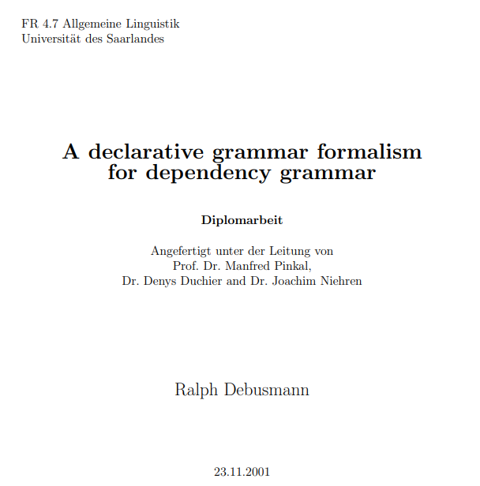
Topological Dependency Grammar
From his ideas, we developed, together with Joachim Niehren, a new grammar formalism for natural language syntax: Topological Dependency Grammar (TDG)
Diploma thesis (2001)

Slide 6
How Does It Work?
Denys‘ idea: Regard the syntactic analysis of natural language as a graph configuration problem
Formulated as a Constraint Satisfaction Problem (CSP) in terms of Finite Domain (FD) and Finite Set (FS) constraints
...and implemented in Mozart-Oz

Slide 7
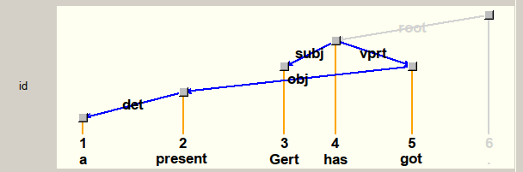
An Example
Idea: Each word corresponds to a node in a labeled (dependency grammar) graph, word order yet unconstrained
Syntactic Analysis of the utterance „A present Gert has got“:

Slide 8
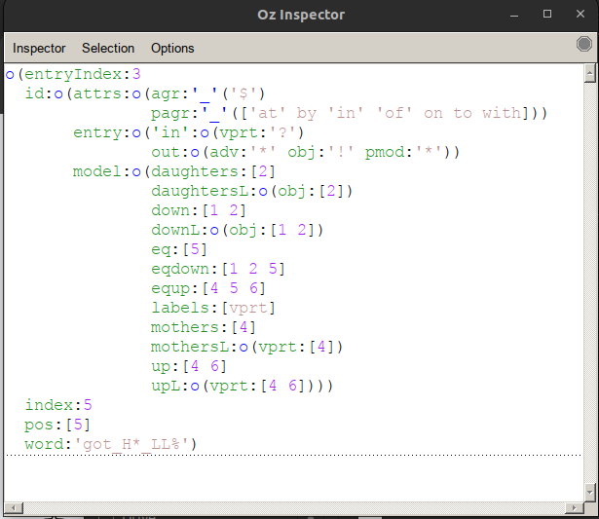
CSP
In the formulation of the CSP, each node is associated with a number of FD and FS variables, e.g.:
Daughters
Mothers
Transitive daughters („down“)
...

Slide 9
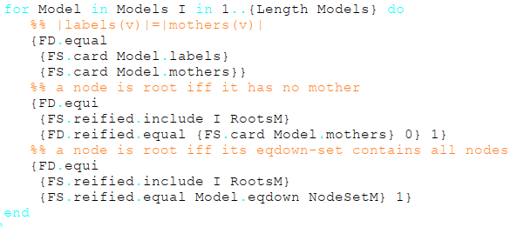
Well-formedness Conditions
The well-formedness conditions of the dependency graphs are stated as constraints on the FD and FS variables:
Globally (e.g. treeness)
Locally (e.g. lexical valency)
Example (Treeness):

Slide 10
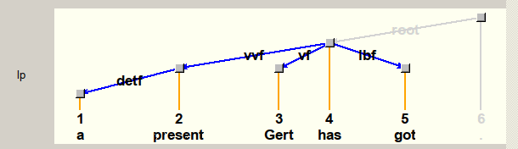
Constrain Word Order
We introduced a second dependency graph to state word order constraints, based on a linguistic theory from the 19th century (Topological Fields):

Slide 11
From Topological to Extensible Dependency Grammar
I was lucky to get the opportunity to get a scholarship (European Graduate College) to continue our work on this idea in my PhD
The Result: Extensible Dependency Grammar (XDG)
Supervisors:
Gert Smolka (Saarbrücken)
Mark Steedman (Edinburgh University)
...and, before they left Saarbrücken:
Denys Duchier
Joachim Niehren

Slide 12
Extensible Dependency Grammar (XDG)
XDG took TDG several steps further
XDG can handle arbitrary many dimensions of multigraphs modeling not only syntactic structure, but also semantics (predicate-argument structure, scope), prosody and information structure
Here is an example (don‘t worry, you don‘t have to understand it, only that we posited a large number of additional multigraph dimensions...)

Slide 13
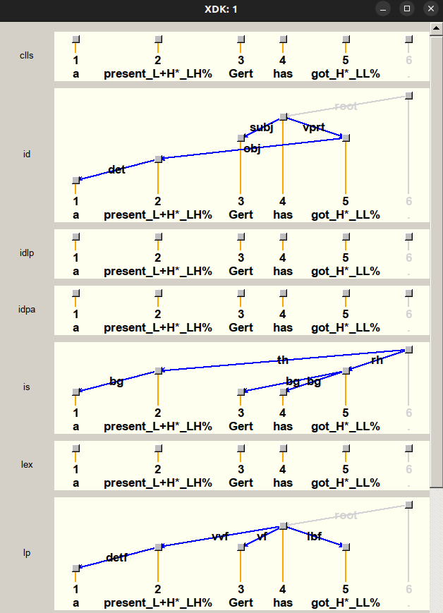
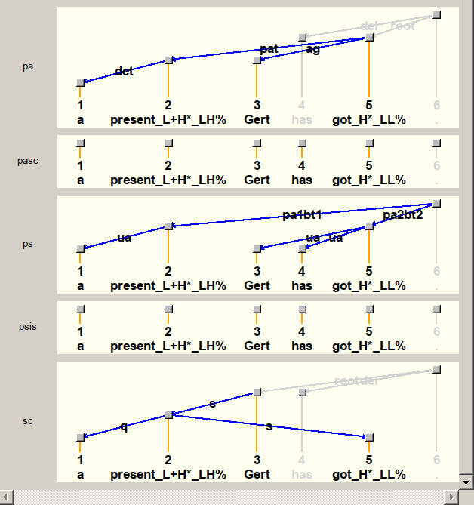
XDG Example Analysis
Predicate- Argument
Structure
Syntactic
Dependencies
Quantifier
Scope
Topological
Fields

Slide 14
Achievements Around XDG
Implementation in Mozart-Oz (including a Principle Compiler, CLLS integration etc.)
First steps toward statistical search and grammar generation (nowadays you would call that Neuro-Symbolic AI) (Dienes/Koller/Kuhlmann 2003, Korthals 2003, Bojar 2004, Narendranath 2004 - SXDG)
NP-hardness proof (Debusmann/Kuhlmann 2007)
Used Gecode (Christian Schulte, Guido Tack et al.) for Constraint Solving instead of Mozart-Oz

Slide 15
The Problems
With XDG, you can not only parse natural language utterances (and get a semantic representation, e.g. in predicate logic)...
... but also generate natural language utterances from a semantic representation.
Was this already some kind of GenAI? Well...
...no. Scale problems:
Problem 1: The underlying grammars needed to be handcrafted by linguists => Extremely time-intensive and expensive, actually unrealistic for large coverage
Problem 2: The constraint parser was too slow for longer utterances or entire text paragraphs (NP-hardness...) – at least several seconds per longer sentence

Slide 16
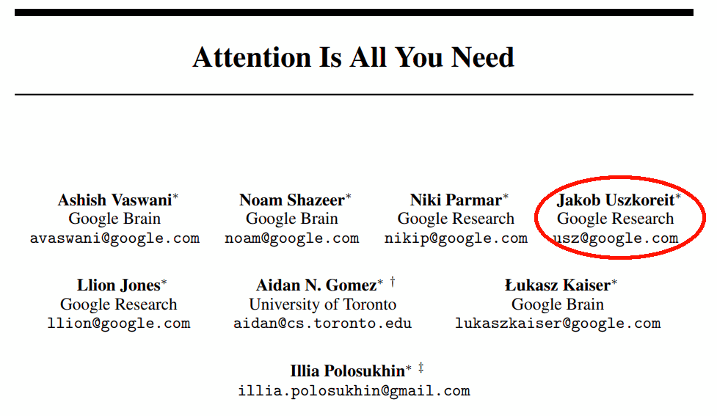
The Age of Large Language Models
So why could XDG still be relevant today, in the age of LLMs?
LLMs are cool – and did you know – Hans Uszkoreit‘s son co-authored the breakthrough paper behind the underlying Transformer model...
But:
No reliable way to get from an utterance to a semantic representation
No reliable way to get from a semantic representation to an utterance
IMHO, LLMs are uncontrollable black boxes

Slide 17
XDG and the Rise of Neuro-Symbolic AI
This is why all kinds of hacks are being applied to fix LLMs:
RAG (Retrieval Augmented Generation)
Agentic AI (modularization, a bit like microservices)
And there is increased research on blending the old symbolic AI with the new purely ML-based AI, e.g. Subbarao Kambhampati, Evgeny Skvortsov
Let‘s go back to XDG. With LLMs, we could mitigate its first scale problem: We could use LLMs to create XDG grammars (semi-)automatically.
First approaches exist, e.g. for LFG, another grammar formalism: Spencer/Kongborrirak (2024)

Slide 18
XDG and Quantum Computing
To mitigate the second scale problem of XDG, we could look at Quantum Computing
New Quantum and Quantum Annealing Computers are getting better and better error correction, e.g. Google‘s Willow – with breathtaking results at least on benchmarks
Now as for XDG: How about implementing the constraint solver on a Quantum Computer? First attempts in this direction are already being undertaken, e.g. Codognet (2024)
=> Hope is not completely lost with XDG ;-)

Slide 19

2 Down-to-Earth Software Engineering

Slide 20
2 Down-to-Earth Software Engineering
In 2007, I had to “go down“ from Academia and “AI“ to down-to-earth software engineering – why?
Hard to find a permanent position in academia...
Family
Not an abundance of “AI jobs“ in the industry as well at that time (still AI winter)
So I went to SAP to work on Software Logistics (Java), the (at that time) new HANA database (C++), UI Translation tooling (Java, ABAP, JavaScript)
Before I had a reveleation...

Slide 21
Scala
In 2014, I discovered the Scala programming language and was intrigued again
Scala? Back in WS 2005/6, I co-organized a seminar on “Advanced Functional Programming“ with Christian Lindig, Andreas Rossberg, Gert and Jan Schwinghammer – where we mentioned Scala already
The inventor of Scala is Martin Odersky, a friend of Gert‘s (first version: January 2004)

Slide 22
From Scala to Kafka
Especially two very popular Big Data tools were written in Scala:
Spark (now backed by Databricks)
Kafka (now backed by Confluent)
I like 2 most, and fell into the rabbit hole of the data streaming world
...where I am still caved in.

Slide 23
What is Kafka
Data streaming platform to synchronize systems, databases, microservices etc. in (near-)real-time developed at LinkedIn (2009+)
Essentially a message queue with (possibly) infinite persistent storage
Backbone for virtually all bigger apps (LinkedIn, Uber...), used a lot in banking, stock exchanges, retailers, postal services...
AI: Used for RAG database updates and Agentic AI inter-communication (modularized AI, similar to microservices)

Slide 24
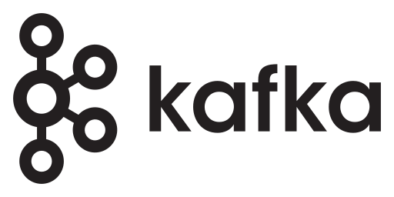
Kafka Illustration
Target System 1
Source System (e.g. database)
Target System 2
Target System 3
...
Target System N

Slide 25
Stream Processing
More interesting than data streaming itself is real-time stream processing
Idea: Incremental processing of data “in motion“, “when it arrives“
In a database: Entire data sets have to be traversed for each operation (e.g. for doing a Join)
Stream processing: Only the changes (“deltas“) need to be processed
Especially important for large quantities of data, e.g. banking and retail (fraud detection etc.)

Slide 26
Consistency
At the beginning of 2023, I discovered the next exciting sub topic
Classical stream processing (up to 2020) only provides very basic consistency guarantees (“eventual consistency“)
That can easily lead to inconsistent data – and this approach is used a lot in banking and retail (!)

Slide 27
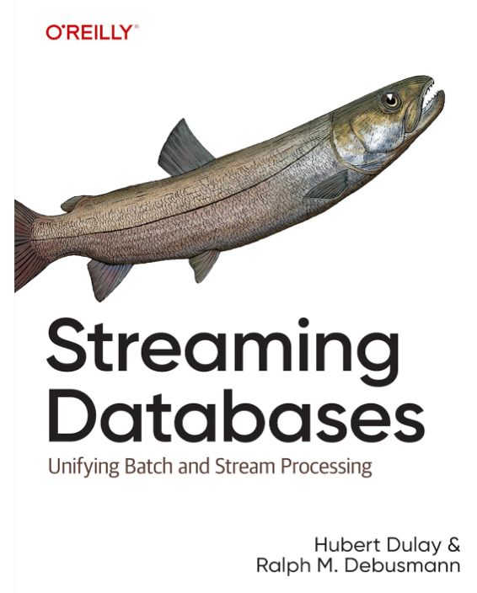
Streaming Databases
Newer approaches based on Differential Dataflow (McSherry et al. 2013) and DBSP (Budiu et al. 2023) offer full consistency as in a database
=> Streaming Databases
O‘Reilly Intro book to streaming databases: Dulay/Debusmann (2024)

Slide 28

3 Back to AI?

Slide 29
Back to AI?
Before being the CTO of an AI startup in the BASF incubator (2022-2023), I discovered the topic of my heart
Started end of 2016 as in internal startup at SAP
Found three seniors and four juniors to implement a prototype, and also create one more patent (US11533298B2)
What does it do?

Slide 30
Back to AI?
Before being the CTO of an AI startup in the BASF incubator (2022-2023), I discovered the topic of my heart
Started end of 2016 as in internal startup at SAP, found three seniors and four juniors to implement a prototype, and also create one more patent (US11533298B2)
I was irritated by the AI hype already in 2016, so what about focusing on Human Intelligence (HI) again?

Slide 31
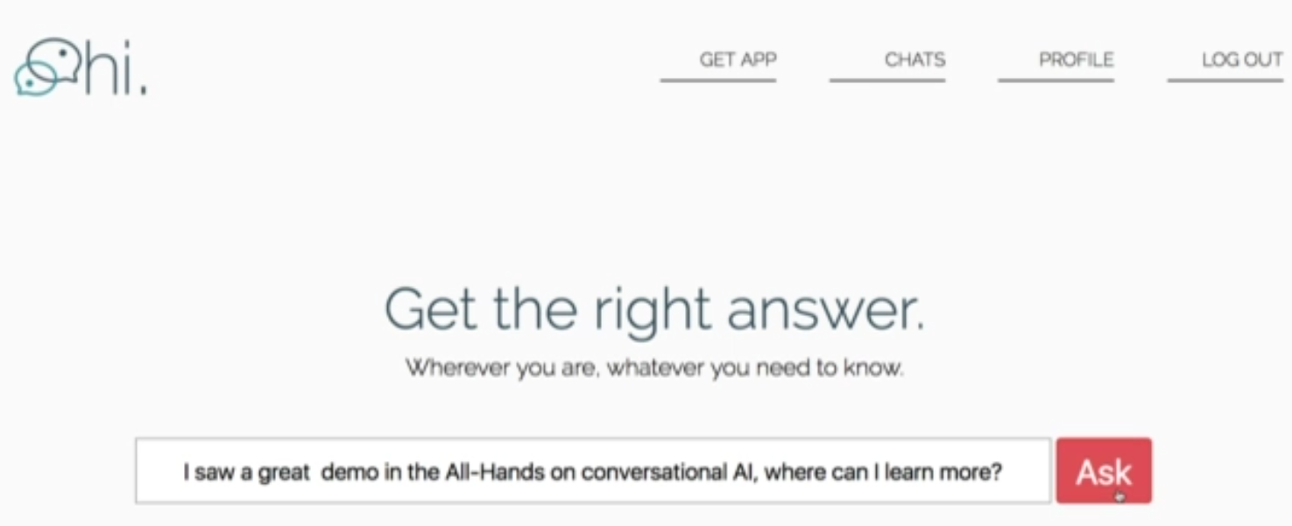
Human Intelligence (HI) – Step 1
Submit a search query/question just like in Google/ChatGPT...

Slide 32
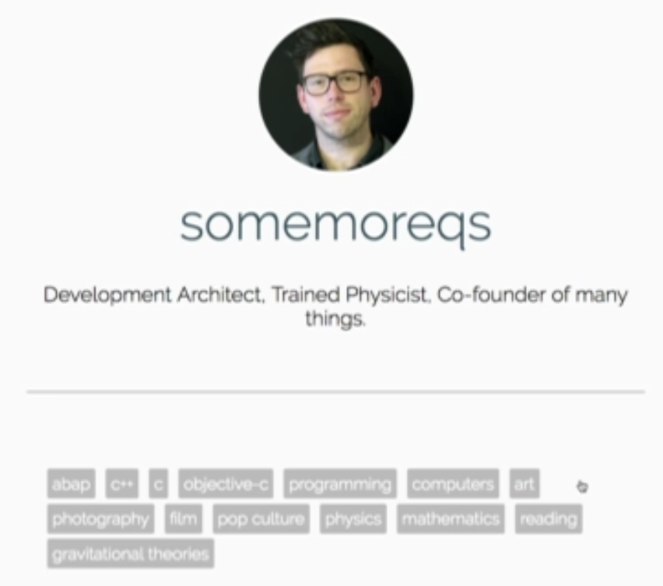
Human Intelligence (HI) – Step 2
We have a profile database of users where they note their skills...

Slide 33
Human Intelligence (HI) – Step 3
We do a matching based on word embeddings (Mikolov et al. 2013) of the query and the profile database
Pure Python coding, no fancy vector databases available at that time
Result: The best possible dialogue partner for the user who submitted the query to answer the query/question...

Slide 34
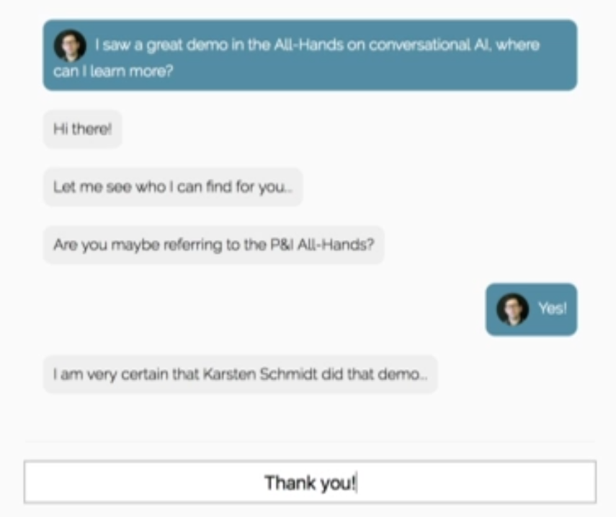
Human Intelligence (HI) – Step 4
Now we throw the user who submitted the query and the best match for the query into a chat, in real-time...

Slide 35
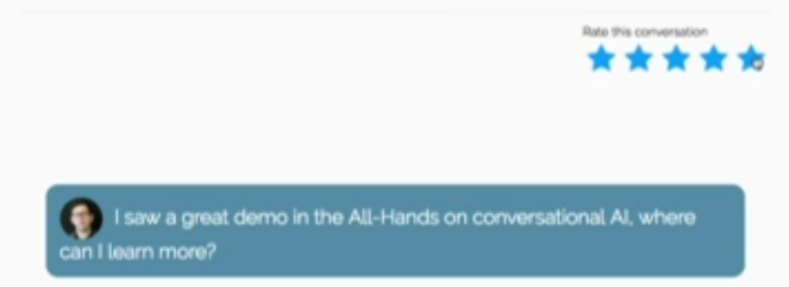
Human Intelligence (HI) – Step 5
After the chat, we ask for a rating and persist it with the chat...

Slide 36
So What Is HI?
Kind of an “online StackOverflow/Reddit/Quora“ – in (near-)real-time
Can be extended in all kinds of ways:
“Human App Store“ where lawyers, doctors etc. can receive money for their help
Hybrid search engine:
Human dialogue partners (HI)
LLM-based dialogue partners (AI)
What do people chose for what query?
Feeds with the most interesting (ongoing) conversations
Gamification of all sorts
Could naturally be extended into a fully-fledged social network like Facebook, LinkedIn...
...and, in theory, become bigger than all of them (megalomaniac alert!)

Slide 37
Has No One Done This Before?
During our research, we found a similar “human search engine“ that had already been built: Aardvark (Horowitz/Kamvar 2010)
Aardvark was acquired by Google in 2010... and shut down in 2011.
NB: At that time, smartphones were still new, there was no WhatsApp, and unlike now, not everybody was (virtually) always online

Slide 38
What Happened to HI
HI was too far away from SAP‘s core business and we didn‘t get any real funding
I wasn‘t daring enough to continue on my own
HI fell asleep

Slide 39
Please Build HI
Please build something like HI now
In 2025, everybody is always online
People would use the internet to help each other, not just to boast on Facebook or Instagram, or get dumber by just watching TikTok videos
People would be encouraged to learn to be able to answer more questions
...and we would use HI again, and AI only for bringing humans together.

